Slide 1
Data Pipelines - I
Pravin Y Pawar

Slide 2
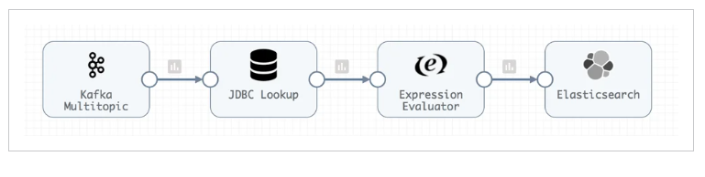
Data Pipeline
What?
Series of steps that allow data from one system to move to become useful in another system
particularly analytics, data science, or AI and machine learning systems
Works by pulling data from the source, applying rules for transformation and processing, then pushing data to its destination.

Slide 3
Data Pipeline(2)
Purpose
Lot of data out there!
Data pipelines transform raw data into data ready for analytics, applications, machine learning and AI systems
keep data flowing to solve problems, inform decisions
Used to:
Deliver sales data to sales and marketing for customer 360
Link a global network of scientists and doctors to speed drug discovery
Recommend financial services to help a small business owner thrive
Track COVID-19 cases and inform community health decisions
Combine diverse sensor data with AI for predictive maintenance
With so much work to do, data pipelines can get pretty complicated pretty fast.

Slide 4
Data Pipeline(3)
Benefits
Data pipelines done right have incredible advantages for companies and organizations, and the work they do.
Self-service Data
Can be created ad hoc by data scientists and business analysts unstick the IT bottleneck
Means when people have brilliant ideas, they can test them, fail fast, and innovate faster
Accelerate Cloud Migration and Adoption
Helps to expand cloud presence and migrate data to cloud platforms
Cloud computing helps to feed many new use cases at processing speeds, cost-effectiveness, and bursting capacity
unheard of in traditional on-premises data centers
Teams can take advantage of rapid innovation happening on those cloud platforms such as
natural language processing
sentiment analysis
image processing
and more.
Real-time Analytics and Applications
Real-time or near real-time functionality in consumer and business applications puts the pressure on data pipelines
to deliver the right data, to the right place, right now
Streaming data pipelines deliver continuous data to real-time analytics and applications

Slide 5
Data Pipeline(4)
Challenges
Always Under Construction Data
Building and debugging data pipelines takes time
Have to align with the schema, set sources and destinations, check work, find errors, and back and forth until
one can finally go live
by which time the business requirements may have changed again
That's why many data engineers have such a backlog of work
Out of Order Data Pipelines
Even a small change to a row or a table can mean hours of rework, updating each stage in the pipeline,
debugging, and then deploying the new data pipeline
Data pipelines often have to go offline to make updates or fixes
Unplanned changes can cause hidden breakages that take months of engineering time to uncover and fix
These unexpected, unplanned, and unrelenting changes are referred to as “data drift”.
Build It and They Will Come
Data pipelines are built for specific frameworks, processors, and platforms.
Changing any one of those infrastructure technologies to take advantage of cost savings or other
optimizations can mean weeks or months of rebuilding and testing pipelines before deployment.

Slide 6
Data Pipeline(5)
Working
When a data pipeline is deployed and running
pulls data from the source
applies rules for transformation and processing
then pushes data to its destination
Data sources
handle data in very different ways and might include applications, messaging systems, data streams,
relational and NoSQL databases, cloud object storage, data warehouses, and data lakes
data structure varies significantly, depending on the source
Transformations
Changes to data structure, format, or values as well as calculations and modifications to the data itself
A pipeline might have any number of transformations embedded to prepare data for use or route it correctly
Destinations
systems where the data is ready to use, put directly into use, or stored for potential use
include applications, messaging systems, data streams, relational and NoSQL databases, data warehouses,
data lakes, and cloud object storage

Slide 7
Data Pipeline(6)
Working
5 Common Data Pipeline Sources
JDBC
Oracle CDC
HTTP Client
HDFS
Apache Kafka
Common Transformations
Masking PII (personally identifiable information) for protection and compliance
Converting data type for fields
Calculating based on a formula or expression
Renaming fields, columns, and features
Joining or merging datasets
Converting data formats (JSON to Parquet, for example)
Generating Avro Schema and other schema types on the fly
Handling Slowly Changing Dimensions
5 Common Data Pipeline Destinations
Apache Kafka
JDBC
Snowflake
Amazon S3
Databricks

Slide 8
Data Pipeline(7)
Architectures
Batch Data Pipeline
move large sets of data at a particular time or in response to a behavior or when a threshold is met
often used for bulk ingestion or ETL processing
might be used to deliver data weekly or daily from a CRM system to a data warehouse for use in a dashboard
for reporting and business intelligence
Streaming Data Pipeline
flow data continuously from source to destination as it is created
used to populate data lakes or as part of data warehouse integration, or to publish to a messaging system or
data stream
used in event processing for real-time applications
streaming data pipelines might be used to provide real-time data to a fraud detection system and to monitor
quality of service.
Change Data Capture Pipeline (CDC)
used to refresh data and keep multiple systems in sync
Instead of copying the entire database, only changes to data since the last sync are shared
can be particularly useful during a cloud migration project when 2 systems are operating with the same data sets

Slide 9
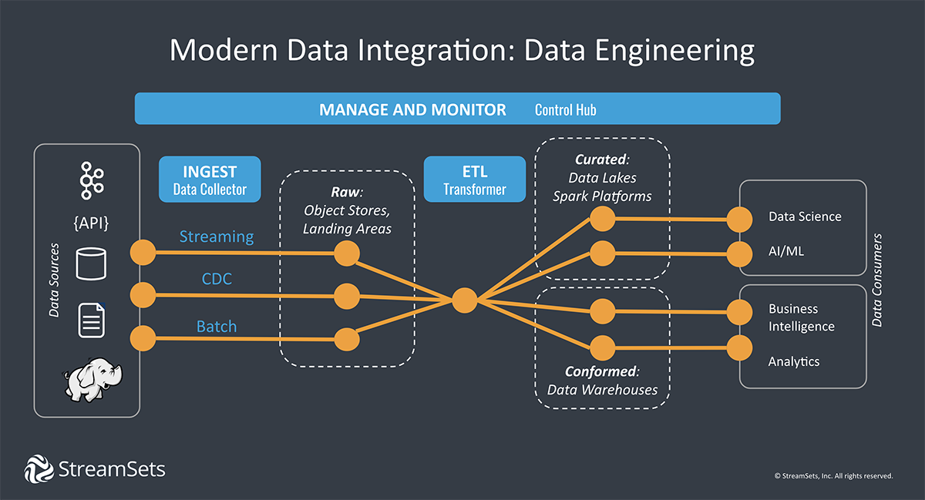
Data Pipeline(8)
Architectures
Architectures

Slide 10
Data Pipeline Tools
Building a single pipeline for a single purpose at a given time is no problem
Can grab a simple tool for setting up a data pipeline or hand code the steps
But how to scale that process to thousands of data pipelines in support of increasing demand for data across organization, over months or years?
When considering data pipeline tools, it is important to think ahead to where your data platform is headed.
Questions to be pondered upon
Are you grabbing data from one place to put it somewhere else? Or do you need to transform it to fit
the downstream analytics requirements?
Is your data environment stable and fully under your control? Or is it dynamic and pulling data from
systems or apps outside of your control?
Will the pipeline move data once, for a short-term analysis project? Or will the pipelines you build need
to be operationalized to handle data flows over time?

Slide 11
Data Pipeline Tools(2)
Data Ingestion and Data Loading Tools
These tools make data pipelines easy to set up, easy to build, and easy to deploy solve the “under construction” issue
but only if you can count on your data scientists to do the data prep work later
Only support the most basic transformations and work best for simply copying data
Instead of being intent-driven, these data pipelines are rigid and embedded with the specifics of data
structure and semantics
Instead of adapting to change when data drift happens, they have to be rebuilt and deployed again

Slide 12
Data Pipeline Tools(3)
Data Integration, Data Transformation Platforms
More complex data integration or ETL software may have a solution for every possible scenario
with hundreds of connectors, integrations, and transformations
But these platforms were designed for an era when data drift hardly happened
Things stayed the same for years
At the first hint of change, these data pipelines break and require massive rework
The demands for digital transformation are moving fast and planning for every possible outcome may
not be possible

Slide 13
Data Pipeline Tools(4)
Data Engineering Platforms
Third way!
A data engineering platform builds smart data pipelines according to DataOps principles
Smart data pipelines abstract away the “how” so you can focus on the what, who, and where of the data
This is the fundamental difference between data integration and data engineering
Instead of being perpetually under construction, out of order, or limited to a single platform
smart data pipelines allow you to move fast with confidence that your data will continue to flow with little
to no intervention
DataOps tools allow you to:
Design and deploy data pipelines in hours, not weeks or months
Build in as much resiliency as possible to handle changes
Adopt to new platforms by pointing to them, a task that takes minutes not months

Slide 14
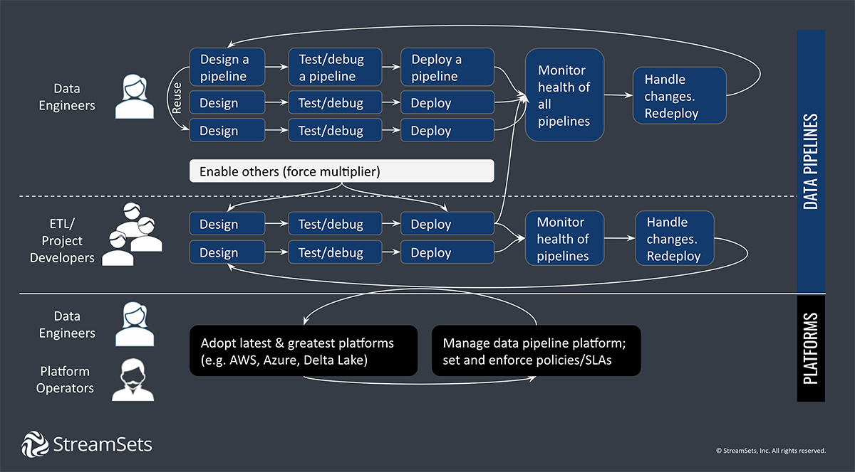
Data Pipeline People

Slide 15
Thank You!
Reference
Smart Data Pipelines: Tools,Techniques, and Key Concepts
In our next session:

